Slide 1


Final Cooling with Thick Wedges for a Muon Collider
Daniel Fu
Diktys Stratakis, David Neuffer
APS April Meeting, 4/3/2024

Slide 2
What is a Muon Collider?
Proposed particle accelerator colliding muons and antimuons
Current particle accelerators use protons or electrons
Electrons lose energy to radiation – harder to reach high energy
Protons are composite particles – collisions more complex
Muons are high mass, elementary particles – best of both worlds
Potential to reach new energy scale (10 TeV) with smaller footprint

Slide 3
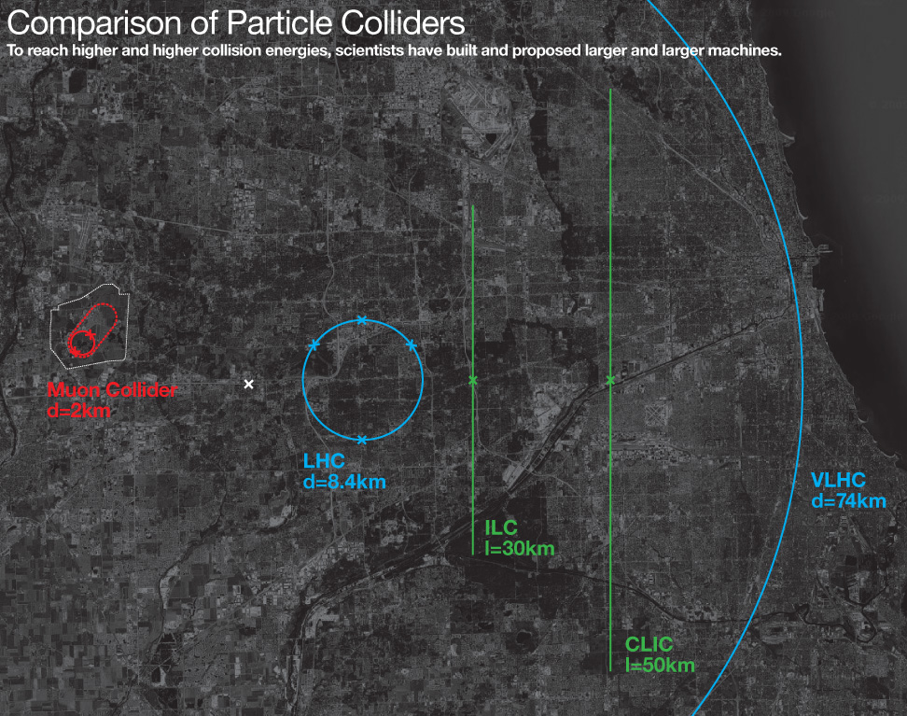
What is a Muon Collider?

Slide 4
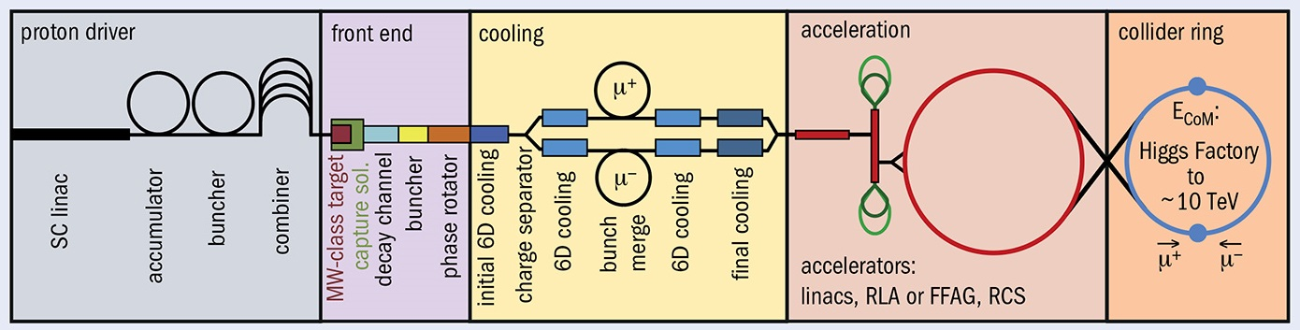
Muon production
Muons are unstable, must produce, accelerate, and collide them before they decay
Proton-target collisions produce pions, which decay into muons

Slide 5
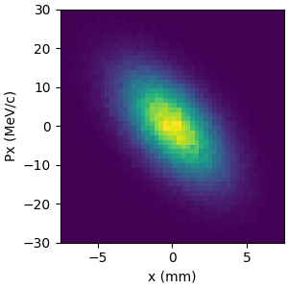
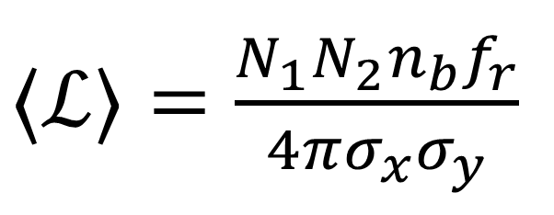
Emittance and Cooling
Emittance = area of distribution in phase-space
Initially high variance in muon position and momentum – measured by emittance
Emittance measured in longitudinal (parallel to beam) and transverse (perpendicular to beam) axes
Reducing emittance is important for maximizing luminosity; this process is known as cooling
$⟨ℒ⟩=\frac{N_{1}N_{2}n_{b}f_{r}}{4πσ_{x}σ_{y}}$
Variances in position related to transverse emittance

Slide 6
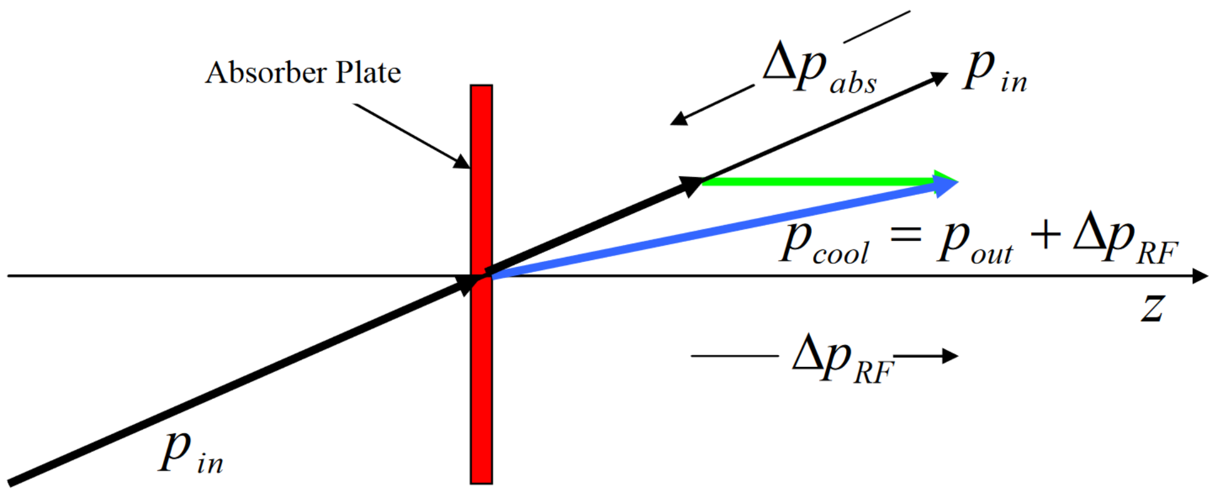
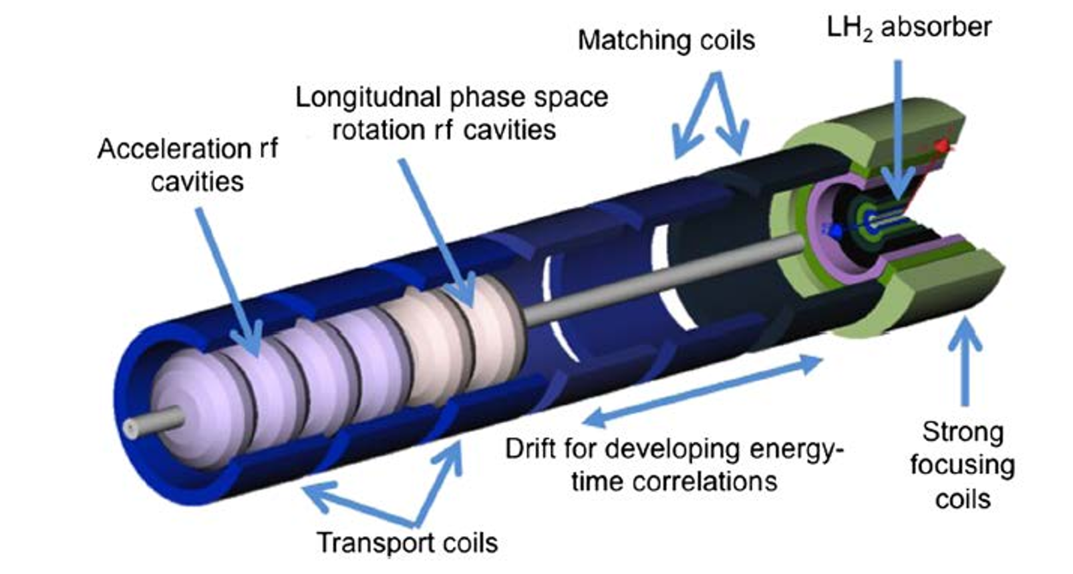
Ionization Cooling
Used because of short lifetime of muon
Beam passed through matter, loses energy through ionization
Momentum reduced in all axes (transverse and longitudinal)
Beam is then reaccelerated with RF cavity
Ends with greater proportion of momentum in longitudinal direction, achieving cooling

Slide 7
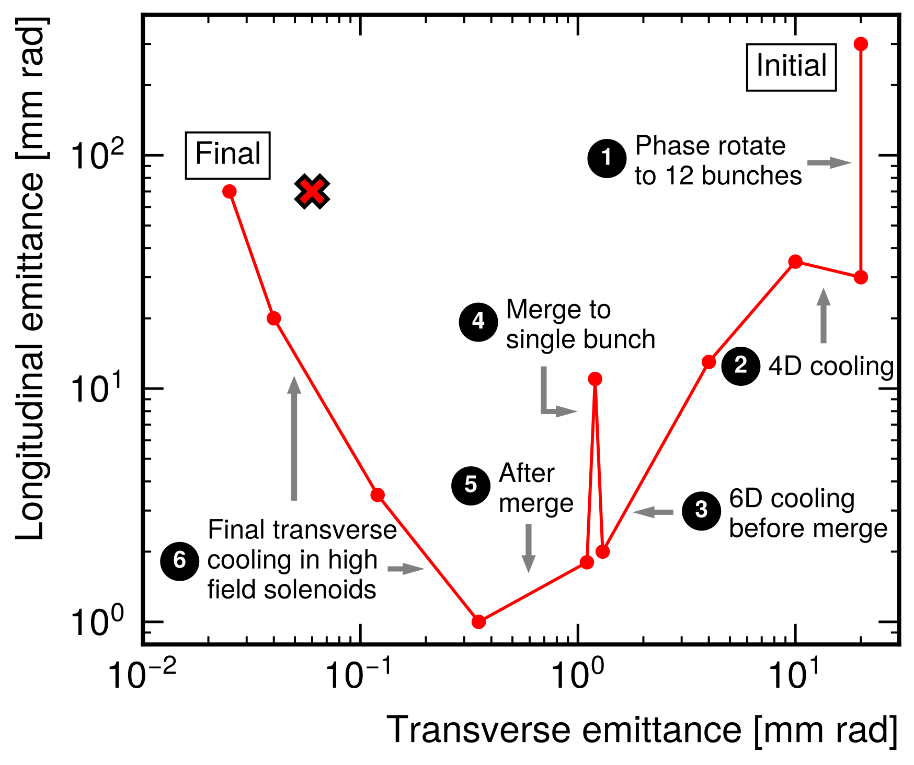
Final Cooling
Cooling occurs in several stages
Initial stages reduce emittance in all axes (6D cooling)
Final cooling reduces transverse emittance, longitudinal emittance allowed to grow (4D cooling)
Target emittance around 30 μm transverse, 100 mm longitudinal

Slide 8
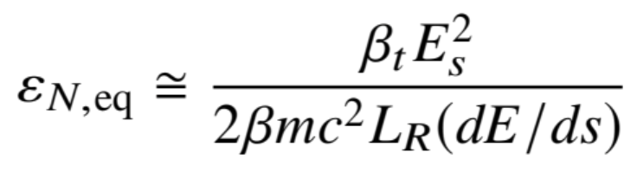
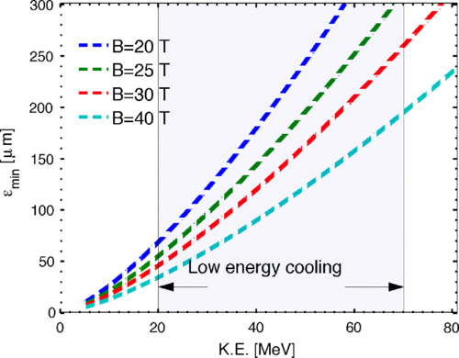
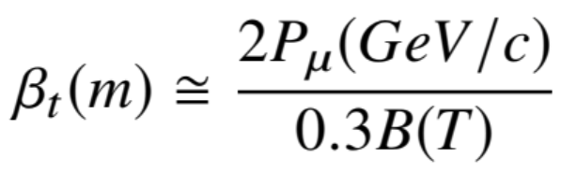
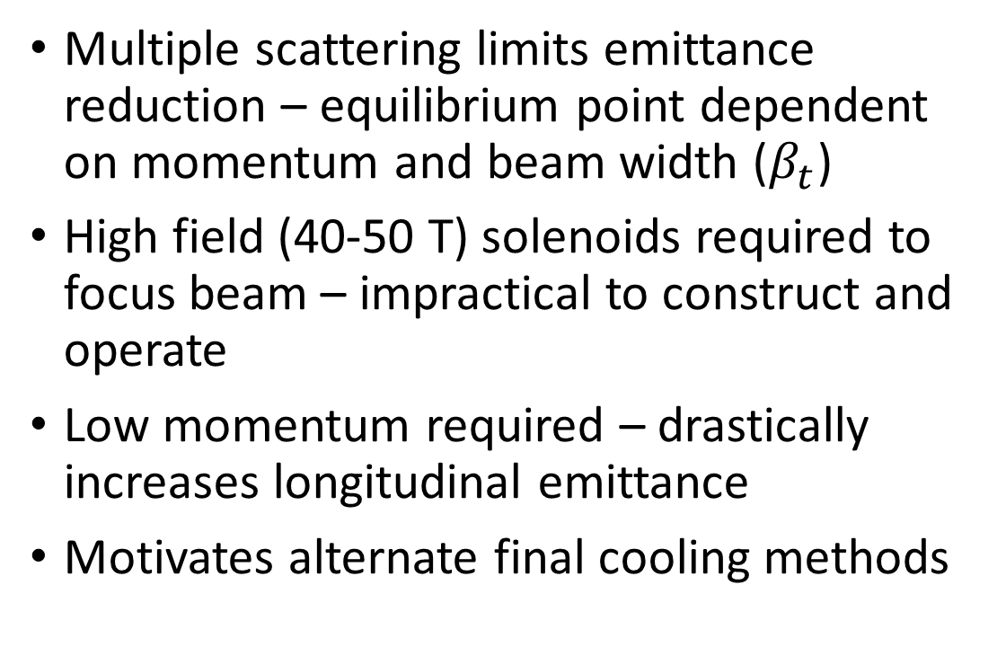
Problems with Baseline Final Cooling
Multiple scattering limits emittance reduction – equilibrium point dependent on momentum and beam width ($β_{t}$)
High field (40-50 T) solenoids required to focus beam – impractical to construct and operate
Low momentum required – drastically increases longitudinal emittance
Motivates alternate final cooling methods

Slide 9
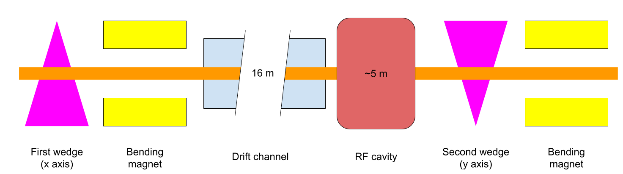
Final Cooling with Thick Wedges
Conceptual final cooling design proposed by Neuffer in 1612.08960
Utilizes wedge-shaped absorbers to achieve emittance exchange
Alternative means of emittance exchange – lower field requirements

Slide 10
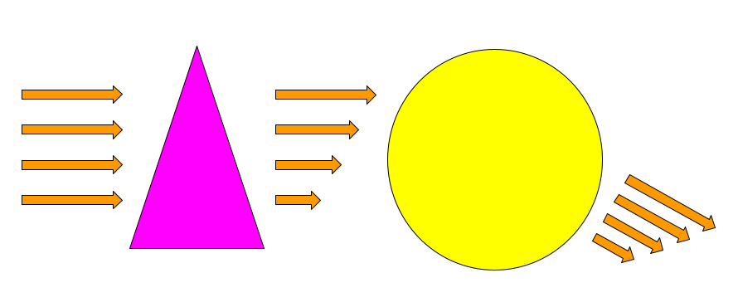
Wedge Cooling Mechanism
3. Bending magnet deflects particles by amount proportional to momentum
2. Muons encounter varying amounts of wedge material, thus decelerate by different amounts
1. Beam enters wedge absorber
4. Resulting beam has lower transverse emittance but higher spread in longitudinal momentum

Slide 11
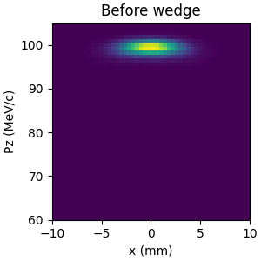
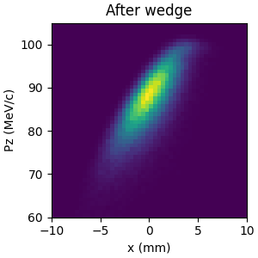
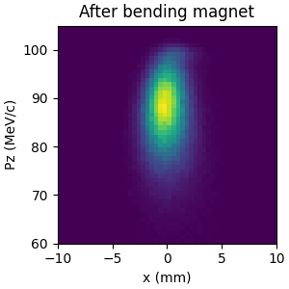
Wedge Cooling Mechanism

Slide 12
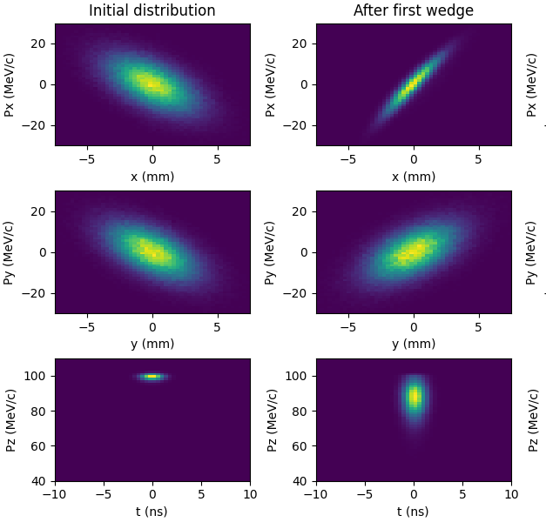
Wedge Cooling Mechanism
Emittance in axis of wedge (x) decreases
Emittance in second transverse axis (y) unchanged
Emittance in longitudinal (z) axis increases due to increased spread in momentum
Momentum spread must be reduced before second wedge

Slide 13
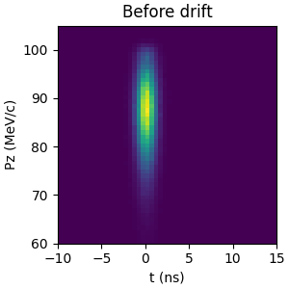
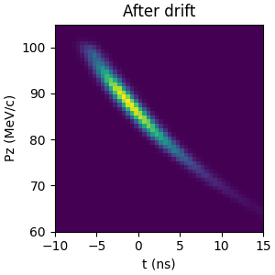
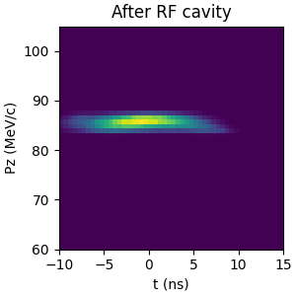
Phase Rotation
Particles travel through drift channel – correlation between z and Pz
RF cavity applies time-varying E-field – decelerates faster muons and accelerates slower muons
Decreases longitudinal momentum spread at the cost of increasing longitudinal position spread (longitudinal emittance unchanged)

Slide 14
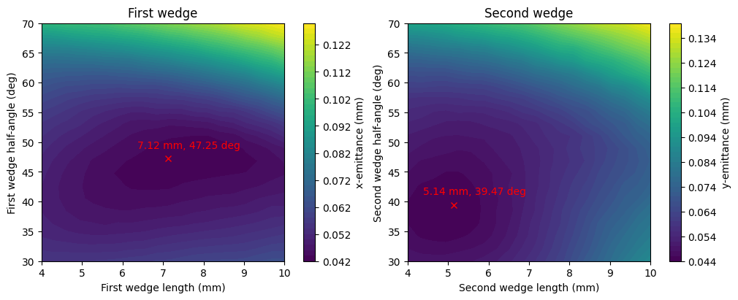
Simulation and Optimization
Simulated using G4Beamline software
Optimization conducted using Nelder-Mead method (scipy)
Optimized 1st wedge, drift length, RF cavity, and 2nd wedge sequentially

Slide 15
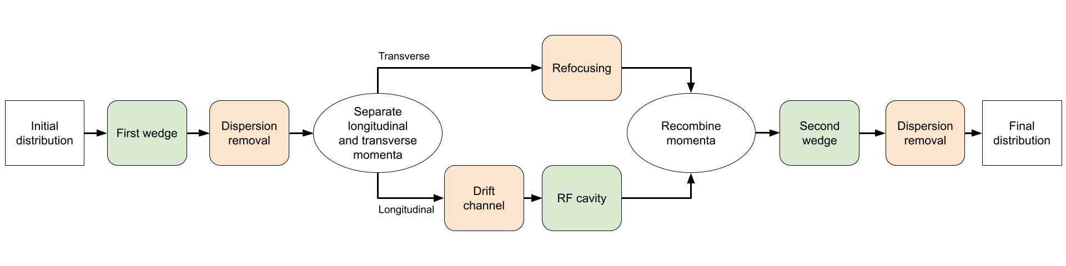
Caveats and Assumptions
Magnets for focusing, beam transport, and bending were not designed – idealized versions assumed
Required magnet strengths not precisely known
Only longitudinal behavior was considered in the RF cavity
Losses from muon decays and inter-particle interactions ignored
Green: Step simulated in G4Beamline
Orange: Step not simulated; assumptions made

Slide 16
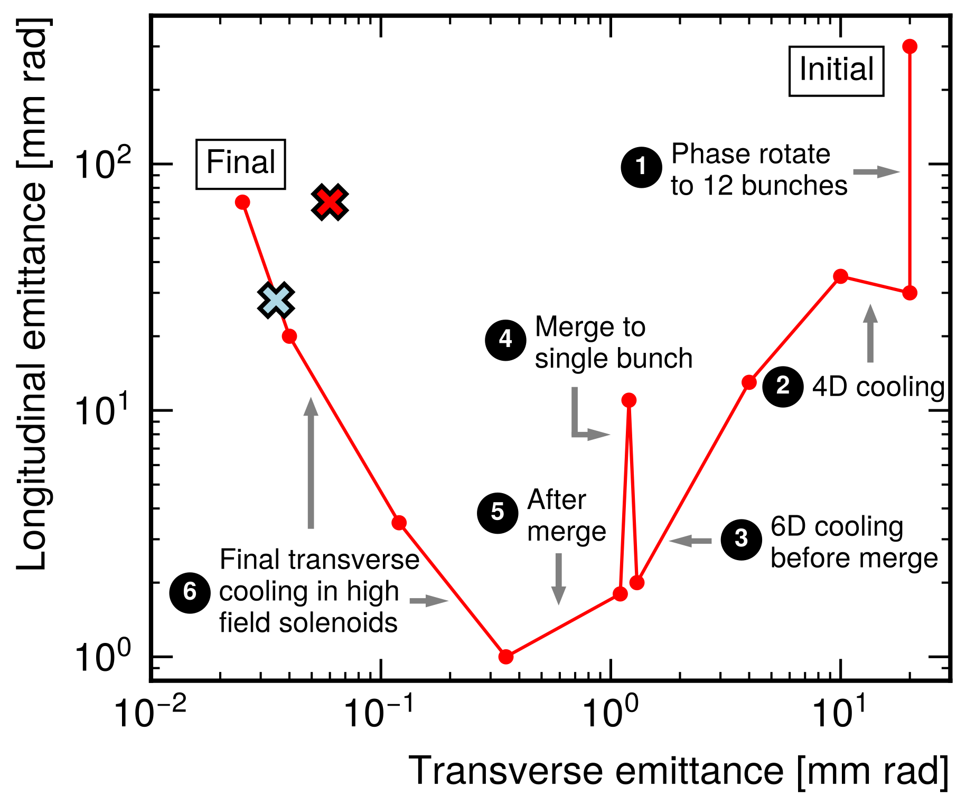
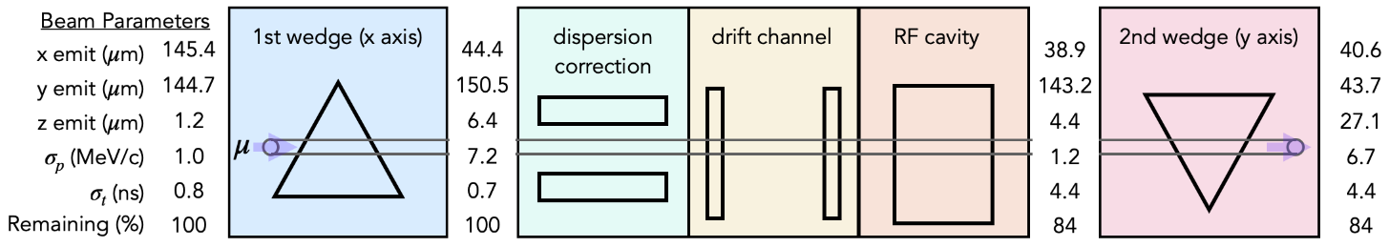
Results
Optimized conceptual design
Achieved lower transverse emittance than previous best results
Demonstrated cooling from first and second wedges

Slide 17
Next Steps
Improve simulation and optimization
Include magnets in simulation to reduce assumptions
Global optimization using Bayesian methods and surrogate modelling
Validate results v.s. particle count and other parameters
Combine wedges with other cooling methods
Demonstrators for wedge cooling technology

Slide 18
Backup slides

Slide 19
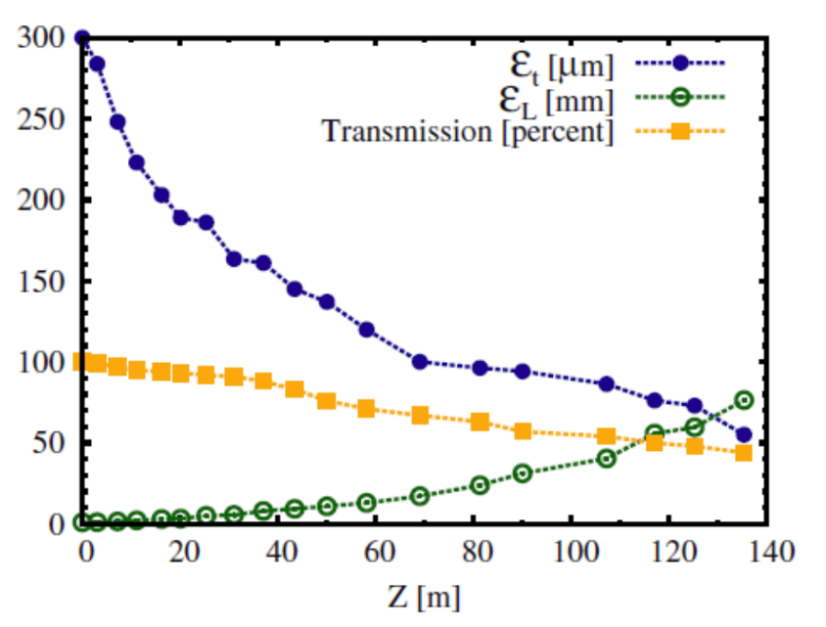
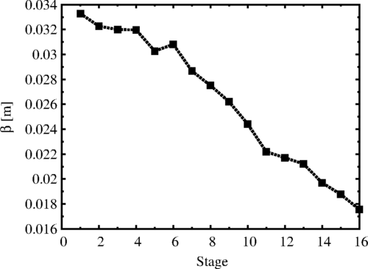
Baseline Graphs
Source: 1612.08960
Source: 10.1103

